Slide 1
OOH MULTIPLIER EFFECT
2018

Slide 2



RELATIONSHIP BETWEEN MEDIA SPEND
AND BRAND METRICS
Notes:
You Gov: 800,000+ individuals
4,000 surveys daily
1250+ brands,
36 Sectors,
16 metrics
All brands spent 5m-25m on media

Slide 3

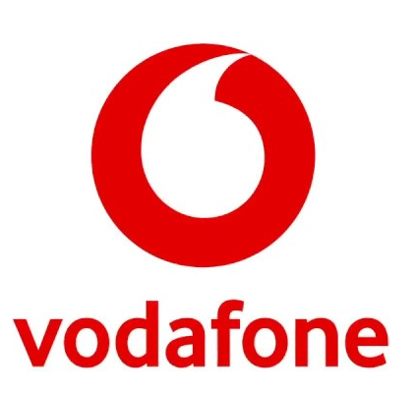

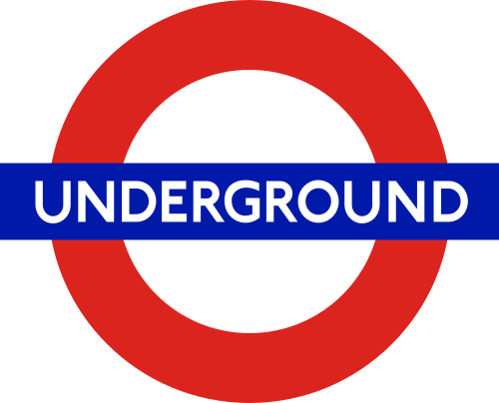
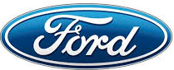
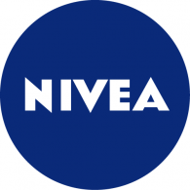


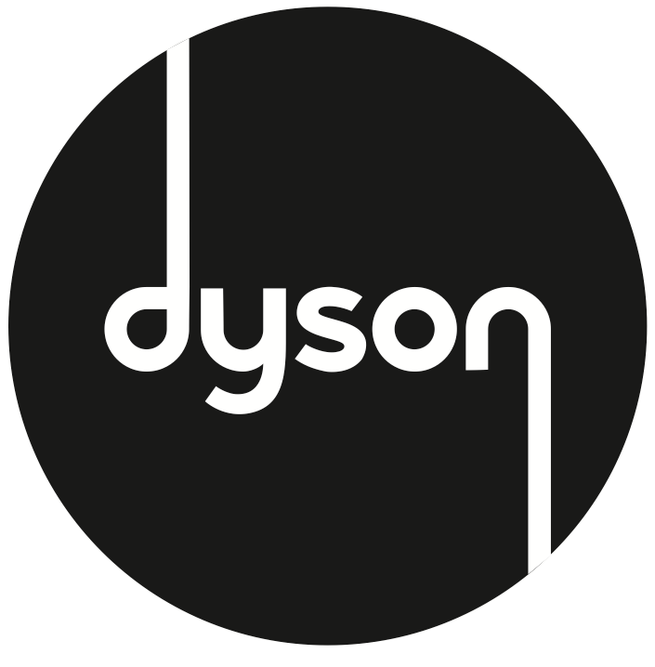



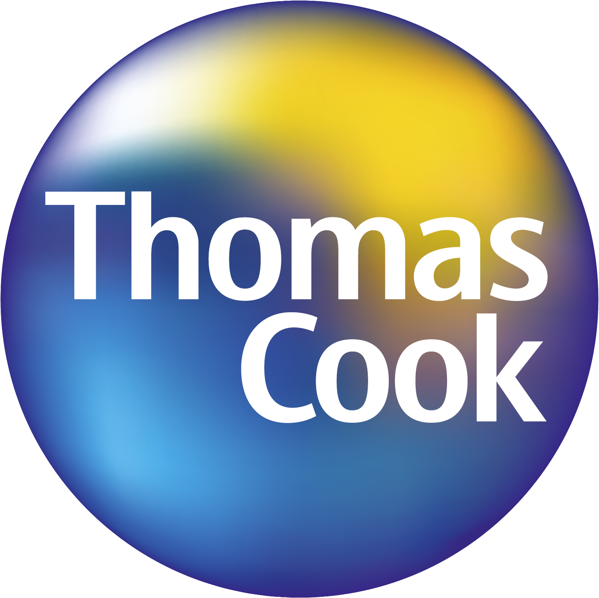

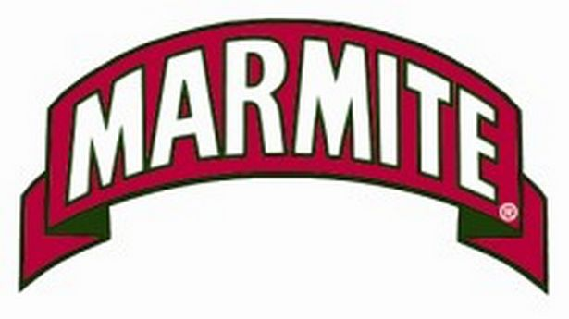


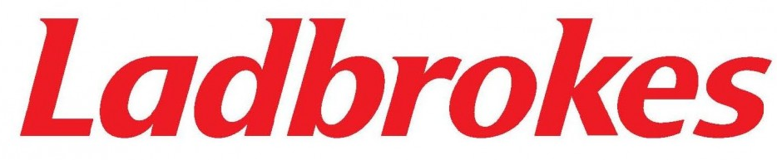
You Gov: daily survey covering 1200 brands and 36 sectors

Slide 4




Metrics examined:
Aided brand awareness Which brands are you familiar with?
Ad awareness Have you seen recent advertising?
Purchase consideration Which brands are you considering purchasing?
Purchase intent Which most likely?
Perception:
General impression What is your positive / negative impression of the brand?
Quality Is the brand of good or poor quality – irrespective of price?
Talkability:
WOM Have you recently spoken about the brand?
Buzz Have you heard anything positive / negative about the brand in the last
two weeks?
Notes:
Media Focused Metrics
Aided Brand Awareness
Advertising Awareness
Word of Mouth (WOM) Exposure
Buzz
Lower Funnel Metrics
Purchase Consideration
Purchase Intent
Underlying Brand Health Metrics
General Impression
Recommend
Quality

Slide 5
Brands that spend on ooh have stronger scores

Slide 6
Brands that spend on ooh have stronger scores
Brands who spend on media, but not OOH £10.5m
Brands who spend on OOH (and other media) £12.1m

Slide 7
Cost per % calculation:
£12.1m
£124 (000)
84
Brands who spend on OOH
(and other media) £12.1m

Slide 8
OOH makes media spend more efficient
x1.5
X1.9
X1.6
x1.5

Slide 9
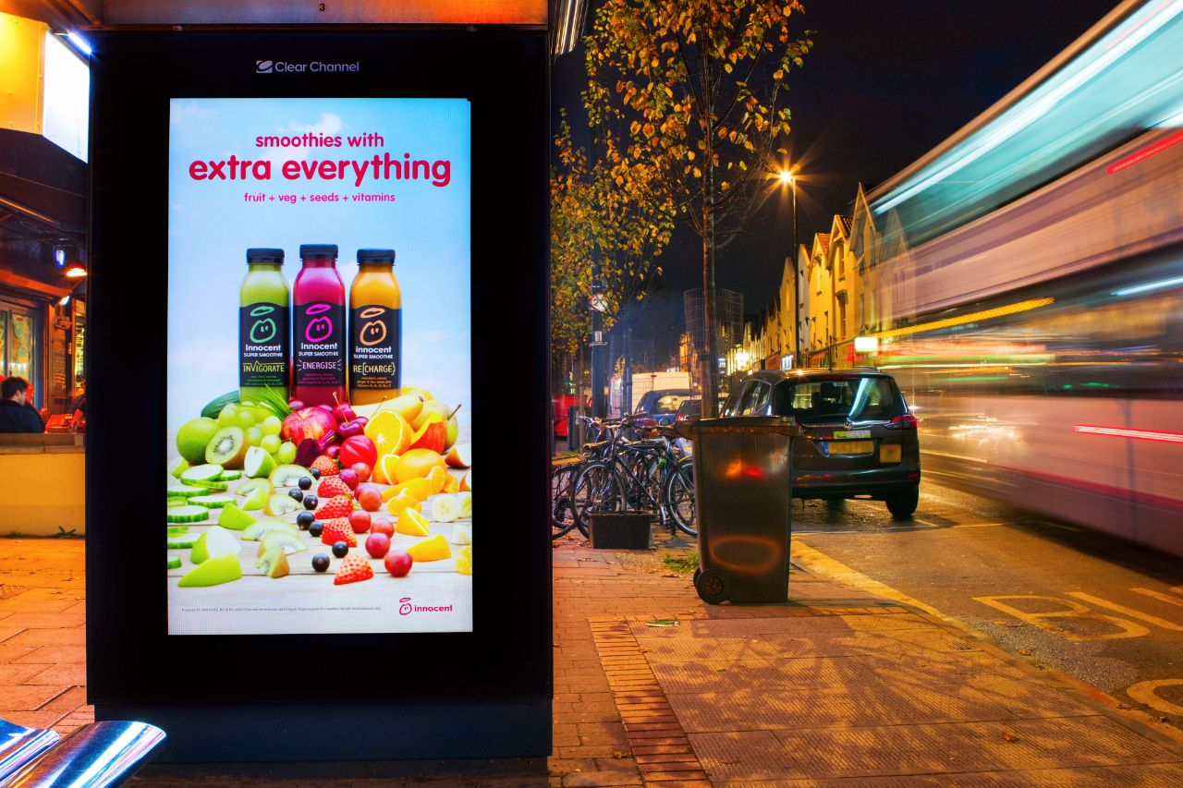
two reasons for this
Mixed media contacts improve attentiveness
OOH cost effectively adds reach and frequency

Slide 10
OOH HAS THE GREATEST POTENTIAL DAILY REACH OF ANY MEDIUM
Sources: Touchpoints7

Slide 11
OOH adds incremental reach to TV campaigns
Campaign Performance | 1+ Cover | GRPs (TVRs)
Solus TV – 100% | 77% | 400 – TV
TV & OOH – 75% : 25% | 89% | 300 – TV 393 – OOH
+13%pt
Source: Touchpoints

Slide 12
When a higher % of the budget is spent on ooh the efficiency is even higher
X2.2
x2.2
x1.3
x2.0
X2.8

Slide 13
At higher spend levels, ooh is more efficient at driving brand perception and purchase intent

Slide 14
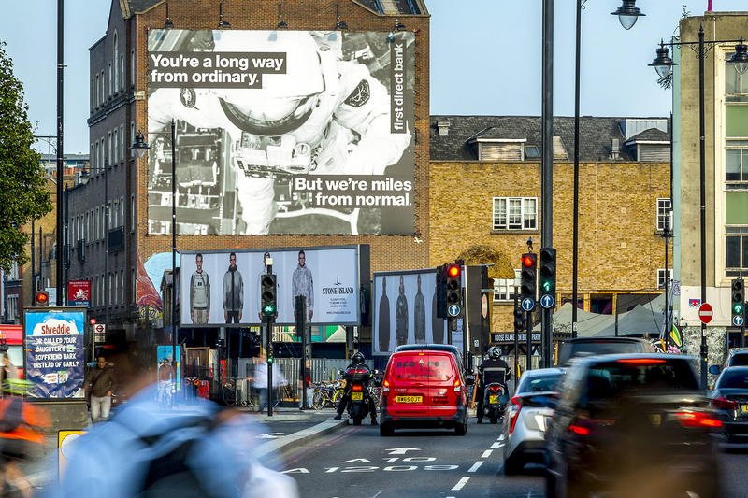
learnings
Brands that spend on OOH have stronger brand metrics
Adding OOH makes media spend more efficient – up to twice as efficient for purchase intent
Brands that spend greater than 20% of their media budget on OOH are even more efficient.
Higher levels of OOH spend are more effective at driving positive brand perception and purchase intent

